Slide 1
Instructional Framework: Engagement

Slide 2
Continuing Our Plan
We will successfully advance our priorities and meet our goals as a district if we rely on a research-based, experience proven plan for improving instruction in every classroom.
Centered on:
What We Teach (Curriculum)
How We Teach (Lesson Structures)
Authentic Literacy
“These three things…a content rich curriculum, sound lessons, and purposeful reading, writing and talking… if even reasonably well-executed, would have more impact than all other initiatives combined….would wholly redefine what public schools can accomplish with children of every socioeconomic stratum.”
Schmoker, Focus, 2011.

Slide 3
What We Teach
“Curriculum may be the single largest factor that determines how many students in a school will learn.” (Marzano, 2003)
Fall 2017:
Began a renewed emphasis on getting our curriculum right
Math, K-12
ELA K-2 and pilot in 3-12
All other content areas focusing on incorporating text every day
Spring 2018:
Purchased aligned curriculum
Eureka Math, K-12
CKLA Skills and Listening & Learning, K-2
Expeditionary Learning, 3-5
Learnzillion, 6-12
Fall 2018:
Continue walk-throughs with the Instructional Framework
Tool focused on ensuring fidelity to implementation of high–quality instructional materials

Slide 4
How We Teach
“Effective teaching is not some complex combination of talent, technique, or long experience…anyone can immediately implement the most essential, common elements of good teaching with success—and get better at them with practice.” (Schmoker, 2011)
Identifying research-based, time-proven aspects of effective instruction
We must decrease the variability of the effectiveness of instruction from room to room, school to school.
Directly aligns with our curriculum work and complements the IPG indicators

Slide 5
Authentic Literacy
“The clearest differentiator in reading between students who are college ready and students who are not is the ability to comprehend complex texts.” (ACT, Reading Between the Lines, 2006)
Authentic literacy is purposeful reading, writing, and discussion about texts in order to build skills and knowledge.
Will be accomplished by the texts and tasks in the new ELA curriculum
Must be integrated into all other subjects (except math)
Literacy is the spine that holds all of this together.
Every person in our district is a reading teacher.
Unless you are a math teacher, your class should include one or multiple texts every single day.
Improving literacy is an educational issue, an economic issue, and a moral issue.

Slide 6
Instructional Framework
Starter
Engagement
Ending
HOW
WHAT
IPG
Core Action 1
Core Action 2
Core Action 3
IPG
Core Action 1
Core Action 2
Core Action 3
IPG
Core Action 1
Core Action 2
Core Action 3
Notes:
How do you interpret this slide?

Slide 7
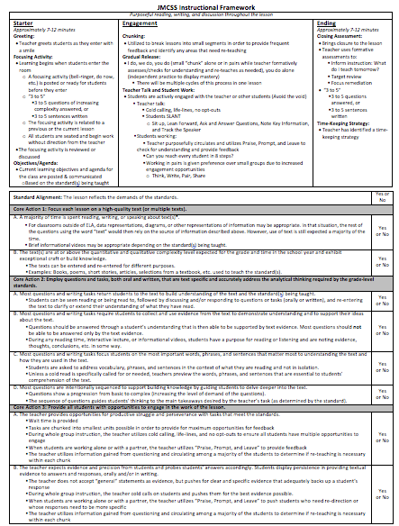
The “How”: Starter, Engagement, Ending
Measuring The “What”:
Core Actions 1, 2, and 3 of the IPG

Slide 8
The “How”
Starter, Engagement, Ending

Slide 10
The “What”

Slide 11
IPG Walkthroughs
Core Action 1: Lesson is focused on complex text (literacy) or standards-aligned tasks (math)
Core Action 2: Opportunities for completing tasks that meet the standards
Core Action 3: Fully engaging students with tasks

Slide 12
Engagement

Slide 13
Engagement: Overview
Chunking
Gradual Release
Teacher Talk and Student Work

Slide 14
Engaging Students
This is where you will spend a majority of every lesson.
How can we tell if students are learning?
Formative assessments conducted by monitoring various forms of engagement…
Regardless of what type of task or assignment is involved, we are always monitoring engagement and understanding by checking student understanding through questioning and/or circulation.
We are never done working on this part of a lesson…there are always ways in which we can increase student engagement!

Slide 15
Visualizing a Lesson
All lessons are made up of big chunks and little chunks.
Big chunks are segments of the lesson that align with the objectives for the day. In many cases, each objective will account for one big chunk of the lesson.
Within each big chunk, teachers break down content into smaller and smaller chunks as part of the instructional process.
Example:
In Lesson 13 of the 6th Grade ELA unit on Hatchet, the objectives are as follows:
Read a mentor text
Discuss how point of view influences a text
Write a narrative from Brian’s point of view
These three objectives are the three big chunks or segments of the lesson.

Slide 16
Chunking
Objectives:
Read a mentor text
Discuss how point of view influences a text
Write a narrative from Brian’s point of view
If we just asked students to complete these activities without more guidance, we would have trouble knowing whether or not students were engaged and learning the content of the lesson.
With that in mind, we know we have to break down our objectives (big chunks) into smaller and smaller chunks so we can promote higher engagement and formatively assess (check for understanding) during the instructional process.
Smaller Chunks Used to Accomplish a Single Objective
Objectives (Big Chunks)
Read a mentor text
Discuss how point of view influences a text
Write a narrative from Brian’s point of view

Slide 17
Chunking
For example, to accomplish the first objective we might utilize the following smaller chunks:
Objective/chunk:
Read a mentor text
Smaller chunks necessary to accomplish the main objective/chunk:
Explain the purpose of a mentor text
Discuss difference in the mentor text and the anchor text
What is point of view and why is it important for an author to maintain point of view throughout a text?
What is first person and how is it used?
What are some pronouns we use with first person?
Read text and underline specific elements (excerpts that indicate point of view, first person pronouns, etc.)
Transitions into the second objective/chunk…
Smaller Chunks Used to Accomplish a Single Objective
Objectives (Big Chunks)
Read a mentor text
Discuss how point of view influences a text
Write a narrative from Brian’s point of view

Slide 18
Engagement
During the course of a lesson, only two things are ever happening:
Teachers are talking
Students are working
Depending on which is happening, there are various ways to promote and measure engagement and understanding as big chunks and little chunks are taught.
When teachers are talking, our primary means of engagement is “cold calling” or “random calling”
What if they don’t know?
Utilize life lines and no opt-outs
When students are talking, our primary means of engagement is ”praise, prompt, and leave”
What are students doing and what am I doing?
We can utilize “Think, Write, Pair, Share” over and over in a single class
While they are writing and sharing, you circulate to check their understanding

Slide 19
Engagement through Gradual Release
In general, lessons begin with small chunks being introduced by the teacher talking.
Through a process of gradual release, content and opportunities for engagement become more student-centric.
Moving through I do, we do, you do, you do alone…
This process repeats itself over and over throughout the lesson as many small chunks and big chunks of a lesson are introduced, practiced, and mastered.
We will utilize cold calling/random calling and praise, prompt, and leave as types of formative assessments to let us know when our students are ready to progress.

Slide 20
Gradual Release: “I do, We do…”
Small chunk introduced through teacher talk…
Cold calling/random calling to engage students and gauge mastery…
Is there sufficient evidence of engagement and mastery to proceed?
Yes: Proceed and release more to students
No: Pull back and re-enter the cycle with teacher talk

Slide 21
Gradual Release: “We do, You do…”
Teacher releases to students working alone or in pairs…
Teacher circulates and utilizes Praise, Prompt, and Leave…
Is there sufficient evidence of engagement and mastery to proceed?
Yes: Proceed and release more to students or move on to the next aspect of the lesson
No: Pull back and re-enter the cycle with teacher talk

Slide 22
Gradual Release: Things to Consider
No two lessons are the same, so your gradual release process can and will look different each day.
If you find yourself doing a significant amount of reteaching to individual students or pairs of students, there’s a good chance you need to pull the whole group back together to clarify misunderstandings and start the cycle over.
The purpose of chunking and gradual release is to increase engagement and check for understanding, both of which are vital for student progress.
If we are chunking and gradually releasing effectively, we don’t have to wait until a quiz or test to assess our students’ mastery…we’ll know where they stand every day!

Slide 23
Physical Characteristics of an Engaged Classrooms
Look for students to SLANT:
S- Sit up
L- Lean forward
A- Ask and answer questions
N- Note key information
T- Track the speaker
When students are working, we prioritize working in pairs rather than groups of 3, 4, or 5.
Why?
Increased opportunities for engagement
More for the teacher to check on since all students are accountable to one other person and the task being completed
How should the room be arranged?
Able to reach students in 8 steps (efficient circulation during Praise, Prompt, and Leave)
No S.A.D Teachers….(Sitting At Desk)!

Slide 24
Classroom Seating
Traditional Set-Up
X X X X X
X X X X X
X X X X X
X X X X X
X X X X X
X X X X X
Example of “Engagement Ready” Seating
X X X X X X
X X X X X X
X X X X X X
X X X X X X
X X X X X X
Another Example…there are more!
X X X X X X
X X X X X X
X X X X X X
X X X X X X
X X X X
X X X X

Slide 25
Engagement: Recap
Chunking
Gradual Release
Teacher Talk and Student Work

Slide 26
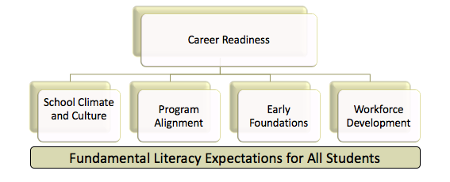
Working Our Plan
By improving our “what” and our “how” while
emphasizing literacy in all areas, we will meet our goals.
This is it.
We must pursue these and not compromise their simplicity, clarity, and focus.

